Slide 1

Secure Electronic Voting Machine with Voter Authentication, Encrypted Vote Storage, and Tamper Detection
PBCST504 – MICROCONTROLLERS
MICRO PROJECT
Zeroth Review

Slide 2
Secure Electronic Voting Machine with Voter Authentication, Encrypted Vote Storage, and Tamper Detection
Title:- Secure Electronic Voting Machine with Voter Authentication, Encrypted Vote Storage, and Tamper Detection
Group No: 1
Members: Adithiyan K Kumar - JEC24CC006
Athul Krishna M B - JEC24CC025
Pooja Muraleedharan- JEC24CC049
Shriram S - JEC24CC054
Vrinda Pillai - JEC24CC063
Project Coordinator:
Ms.Sagna L T
Asst. Prof. CSE(CY)

Slide 3
Secure Electronic Voting Machine with Voter Authentication, Encrypted Vote Storage, and Tamper Detection
DEPARTMENT OF COMPUTER SCIENCE & ENGINEERING
(Cyber Security)
Vision of the Department
To be a globally recognized centre of excellence in Cyber Security education, research and innovation by nurturing ethical professionals , fostering technological advancement through responsible practice and contributing to a secure and sustainable digital society.

Slide 4
Secure Electronic Voting Machine with Voter Authentication, Encrypted Vote Storage, and Tamper Detection
DEPARTMENT OF COMPUTER SCIENCE & ENGINEERING
(Cyber Security)
Mission of the Department
M1: Excellence in Education : To provide outcome-based and industry-oriented education by integrating core computer science principles with advanced cybersecurity technologies and practices.
M2: Ethics and Professional Responsibility : To cultivate ethical values, integrity, social responsibility, and secure computing practices for protecting digital assets and strengthening cyber trust.
M3: Research, Innovation, and Entrepreneurship : To promote research, innovation, and entrepreneurial thinking for developing sustainable solutions to emerging cybersecurity challenges.
M4: Holistic and Global Development : To enhance leadership, teamwork, lifelong learning, and global competence through industry collaboration, interdisciplinary activities, and community engagement.

Slide 5
Secure Electronic Voting Machine with Voter Authentication, Encrypted Vote Storage, and Tamper Detection
Programme Educational Objectives (PEOs)
PEO 1: Graduates will apply strong foundations in computer science and cybersecurity to design, develop, and manage secure and reliable computing systems for industry and society.
PEO 2: Graduates will pursue successful careers as professionals, innovators or entrepreneurs engaged in technology development, deployment or engineering system implementation in industry and society and contribute to the economic growth of the country.
PEO 3: Graduates will demonstrate ethical responsibility, leadership, teamwork, and effective communication while adapting to evolving global technological environments through lifelong learning.

Slide 6
Secure Electronic Voting Machine with Voter Authentication, Encrypted Vote Storage, and Tamper Detection
Programme Outcomes
Engineering Graduates will be able to:
1. Engineering knowledge: Apply the knowledge of mathematics, science, engineering fundamentals, and an engineering specialization to the solution of complex engineering problems.
2. Problem analysis: Identify, formulate, review research literature, and analyze complex engineering problems reaching substantiated conclusions using first principles of mathematics, natural sciences, and engineering sciences.
3. Design/development of solutions: Design solutions for complex engineering problems and design system components or processes that meet the specified needs with appropriate consideration for the public health and safety, and the cultural, societal, and environmental considerations.
4. Conduct investigations of complex problems: Use research-based knowledge and research methods including design of experiments, analysis and interpretation of data, and synthesis of the information to provide valid conclusions.
5. Modern tool usage: Create, select, and apply appropriate techniques, resources, and modern engineering and IT tools including prediction and modeling to complex engineering activities with an understanding of the limitations.

Slide 7
Secure Electronic Voting Machine with Voter Authentication, Encrypted Vote Storage, and Tamper Detection
6. The engineer and society: Apply reasoning informed by the contextual knowledge to assess societal, health, safety, legal and cultural issues and the consequent responsibilities relevant to the professional engineering practice.
7. Environment and sustainability: Understand the impact of the professional engineering solutions in societal and environmental contexts, and demonstrate the knowledge of, and need for sustainable development.
8. Ethics: Apply ethical principles and commit to professional ethics and responsibilities and norms of the engineering practice.
9. Individual and team work: Function effectively as an individual, and as a member or leader in diverse teams, and in multidisciplinary settings.
10. Communication: Communicate effectively on complex engineering activities with the engineering community and with society at large, such as, being able to comprehend and write effective reports and design documentation, make effective presentations, and give and receive clear instructions.
11. Project management and finance: Demonstrate knowledge and understanding of the engineering and management principles and apply these to one’s own work, as a member and leader in a team, to manage projects and in multidisciplinary environments. 12. Life-long learning: Recognize the need for, and have the preparation and ability to engage in independent and life-long learning in the broadest context of technological change.

Slide 8
Secure Electronic Voting Machine with Voter Authentication, Encrypted Vote Storage, and Tamper Detection
Programme Specific Outcomes (PSOs)
On the completion of Computer Science & Engineering program, the students will possess:
PSO 1: Apply cyber security principles to mitigate cyber risk and analyze security requirements of an organization.
PSO 2: Develop and deploy secure software and infrastructure using modern tools and industry standards.
PSO 3: Uphold ethical, legal, and societal responsibilities while protecting privacy, data, and digital assets.

Slide 9
Secure Electronic Voting Machine with Voter Authentication, Encrypted Vote Storage, and Tamper Detection
CONTENTS
Motivation
Introduction
Problem Statement
Proposed Method
Basic Block Diagram
Conclusion
References

Slide 10
Motivation
Secure Electronic Voting Machine with Voter Authentication, Encrypted Vote Storage, and Tamper Detection
Ensure Secure Elections: Develop a voting system that protects against unauthorized access and fraudulent voting.
Prevent Duplicate Voting: Ensure that each registered voter can cast only one vote using RFID authentication.
Protect Vote Confidentiality: Encrypt votes before storing them so that they cannot be real or modified by unauthorized users.
Detect Physical Tampering: Identify any attempt to open or manipulate the voting machine and immediately trigger an alert.
Apply Cybersecurity in Embedded Systems: Demonstrate practical implementation of authentication, encryption, access control, and audit logging using Arduino.

Slide 11
Secure Electronic Voting Machine with Voter Authentication, Encrypted Vote Storage, and Tamper Detection
Introduction
Electronic Voting Machines (EVMs) provide faster and more accurate election processes compared to traditional paper ballots.
Basic EVMs lack sufficient security features, making them vulnerable to unauthorized access and vote manipulation.
This project enhances a conventional Arduino-based voting machine by integrating cyber security mechanisms.
RFID technology is used to authenticate voters, while encrypted storage protects vote confidentiality.
The system also includes tamper detection, admin authentication, and secure vote storage, making it a reliable educational model of a secure voting system.

Slide 12
Problem Statement
Secure Electronic Voting Machine with Voter Authentication, Encrypted Vote Storage, and Tamper Detection
Traditional Arduino-based voting systems do not verify voter identity, allowing unauthorized voting.
There is no mechanism to prevent a person from voting multiple times.
Votes stored in plain text can be easily accessed or modified if the storage device is compromised.
Most basic voting systems cannot detect physical tampering or unauthorized access to the hardware.
Election results are often accessible without proper authorization, compromising election integrity and confidentiality.

Slide 13
Proposed Method
Secure Electronic Voting Machine with Voter Authentication, Encrypted Vote Storage, and Tamper Detection
RFID-Based Authentication: Each voter is assigned a unique RFID card, and only registered cards are allowed to vote.
Duplicate Vote Prevention: After voting, the RFID card status is updated to prevent the same voter from voting again.
Encrypted Vote Storage: Every vote is encrypted before being stored in EEPROM or an SD card to protect confidentiality.
Tamper Detection Mechanism: A limit switch detects unauthorized opening of the machine, triggers or an alarm, and locks the system.
Admin Authentication: A master RFID card provides secure access to election results and system management functions.

Slide 14
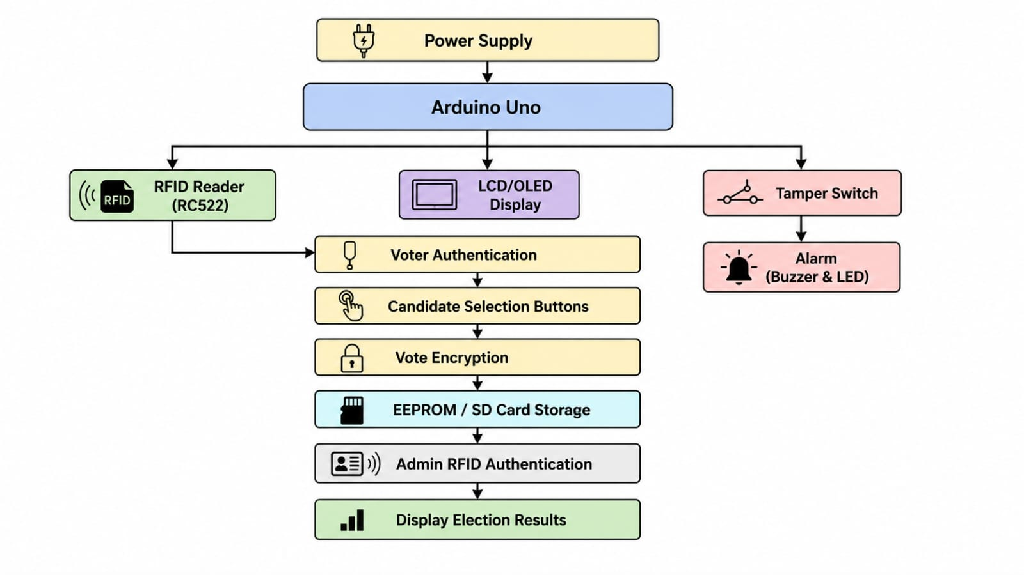
Basic Block Diagram
Secure Electronic Voting Machine with Voter Authentication, Encrypted Vote Storage, and Tamper Detection

Slide 15
Conclusion
Secure Electronic Voting Machine with Voter Authentication, Encrypted Vote Storage, and Tamper Detection
The proposed system enhances a traditional Arduino voting machine by integrating essential cybersecurity features.
RFID authentication and duplicate vote detection ensure that only authorized voters can cast a single vote.
Encrypted vote storage protects the confidentiality and integrity of election data.
Tamper detection and audit logging improve the physical security and accountability of the voting system.
The project serves as an effective educational model demonstrating how embedded systems and cybersecurity principles can be combined to build secure electronic applications.

Slide 16
References
Secure Electronic Voting Machine with Voter Authentication, Encrypted Vote Storage, and Tamper Detection
Arduino Documentation – https://docs.arduino.cc/
MFRC522 RFID Library Documentation – https://github.com/miguelbalboa/rfid
Arduino EEPROM Library Documentation – https://docs.arduino.cc/learn/built-in-libraries/eeprom/
Arduino SD Card Library Documentation – https://docs.arduino.cc/libraries/sd/
William Stallings, Cryptography and Network Security: Principles and Practice, Pearson Education, 8th Edition.

